Slide 1


Armed Forces Regional Data Pack (v3)
Midlands Region
wolverhampton.gov.uk

Slide 2

Explanation – Midlands
Summarise the key findings from the 2021 Census, and other pertinent datasets, as intelligence to be used by the VPPP for their processes.
Summarise information for Counties, compare Counties in Region.
Within this report, “Veterans” are residents who fit one of two Census categories: Either “Previously served in the UK regular armed forces” or “Previously served in both regular and reserve UK armed forces”.
Within this report, the “Reservist” group are residents who were reservists, but who had never served formally.
The number of veterans can vary by dataset in the Census tables in this report, this is due to the way ONS structure and group the Census data for confidentiality reasons.
wolverhampton.gov.uk

Slide 3
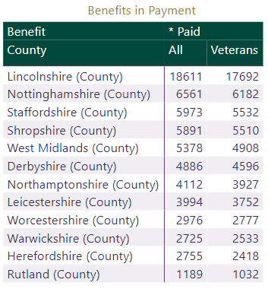
Pensions – Midlands
Statistics on the number of people in receipt of an occupational pension under the Armed Forces Pension Scheme (AFPS), the number in receipt of ongoing pensions under the War Pensions Scheme (WPS) and the number awarded compensation under the Armed Forces Compensation Scheme (AFCS).
Within the area, the local authority with the highest number of payments had ﻿5044 (North Kesteven)﻿ in payment, and the lowest number had ﻿166﻿ (Oadby & Wigston) in payment.
Total paid across the area: ﻿65,051﻿, representing ﻿0.71%﻿ of the population aged 16+
Total paid to veterans specifically: ﻿60,859﻿
Total AFCS across the area: ﻿7,302﻿
Total AFPS across the area: ﻿52,802﻿
Total WPS across the area: ﻿12,919﻿
wolverhampton.gov.uk

Slide 4
Key Findings (Age, Sex, Ethnicity, Health) – Midlands
From Census 2021 data, ﻿287,591﻿ (3.17%) of residents aged 16+ were veterans, and an additional ﻿65,215 (0.72%) were reservists, meaning that ﻿352,806﻿ were either veterans or 'veteran reservists’.
This means ﻿3.89%﻿ of this 16+ population were in either of those two groups, compared to an equivalent for England of 3.78%.
For the ﻿Veterans﻿ group, ﻿89.08%﻿ are male. Additionally, out of this cohort, ﻿162,674﻿ (﻿56.56%﻿) are aged 65+. Within this region, 97.5% are of White ethnicity.
Veterans report being in poorer health than non-veterans, which is to be expected given their age profile.
Even after allowing for age and sex factors, poor health is found disproportionately in the older veteran populations specifically.
Levels of disability higher in the veteran population than the non-veteran cohort.
wolverhampton.gov.uk

Slide 5
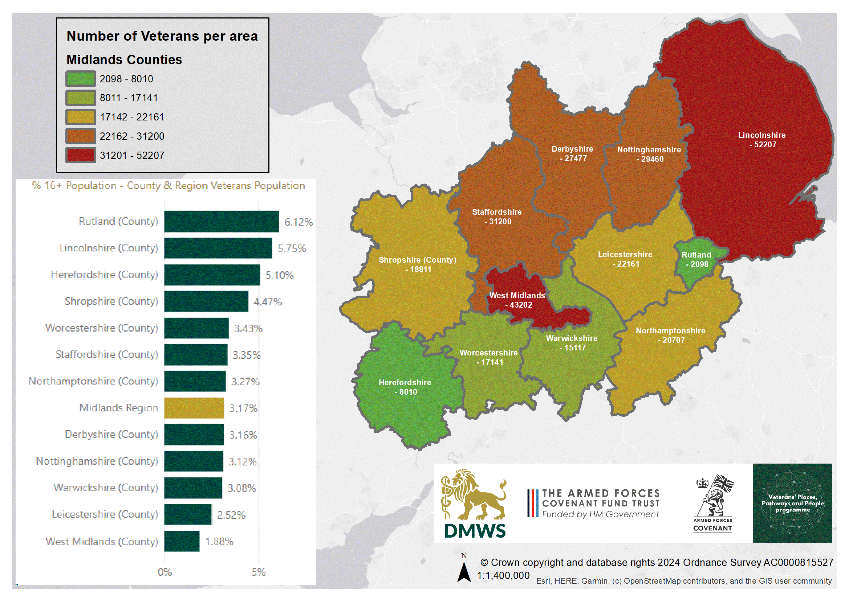

Slide 6
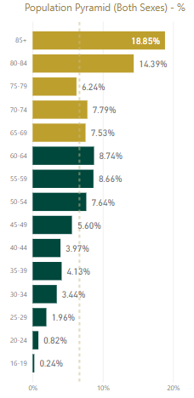
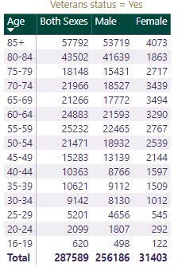
Veteran population in context, age and sex - Midlands
wolverhampton.gov.uk
Dotted line = average age band %

Slide 7
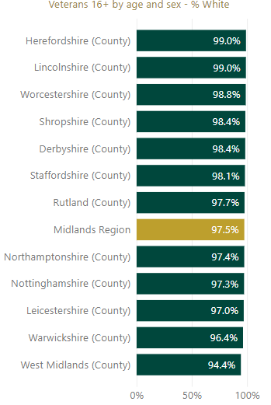
Ethnicity of veterans – Midlands
Of the veteran population, the majority (﻿280,439 or ﻿97.5%﻿) are White ethnicity.
The non-White veterans = 7,164: 1,627 Asian, 2,703 Black, 2,154 Mixed, 680 Other.
The veterans’ population has proportionally fewer Ethnic Minority residents than non-veterans aged 16+. The 65+ age group has a greater share of White veterans than younger age groups.
The veterans’ population has proportionally fewer Ethnic Minority residents than either the overall population, or the region’s non-veterans aged 16+.
wolverhampton.gov.uk

Slide 8
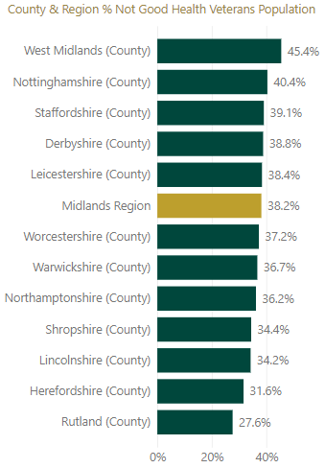
Health of veterans – Midlands
Comparing self-reported health, based on both sex and on whether someone is a veteran or non-veteran, reveals large differences in perceptions of health, however there is no detail in the Census as to prevalence of underlying conditions.
There were ﻿﻿﻿109,748 veterans “not good health", of a total veteran cohort of ﻿287,600﻿﻿﻿.
Notably, 38.2%﻿ of veterans perceive their health as “not good” compared to ﻿22.36%﻿ of non-veterans, and compared to ﻿29.21%﻿ of reservists.
Even after adjusting for age and sex, these differences remain – for example, 52.67% of veteran males 65+ are in “good health”, compared to 41.01% of non-veterans, and 48.63% of reservists.
wolverhampton.gov.uk

Slide 9
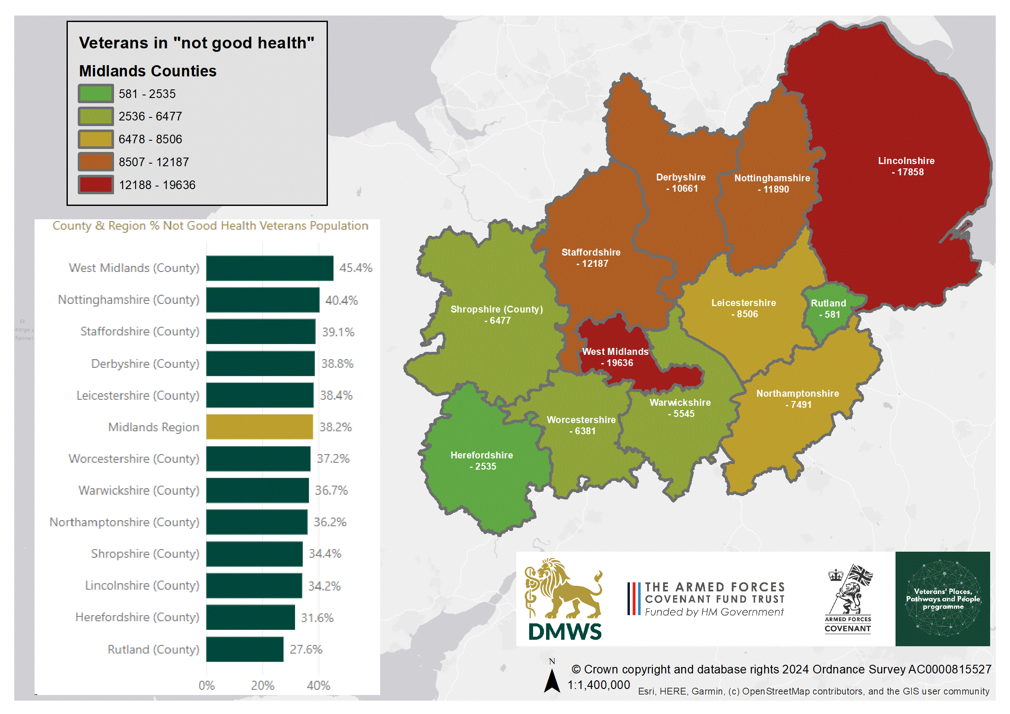
Dotted line = average age band %

Slide 10
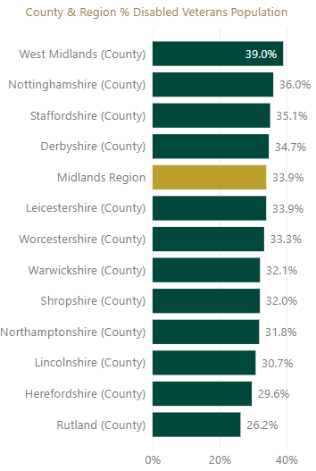
Disability of veterans – Midlands
Comparing disability status, based on both sex and on whether someone is a veteran or non-veteran, reveals large differences in perceptions of health, however there is no detail in the Census as to prevalence of underlying condition, or the type of impairment(s).
There were 97,562 veterans ‘disabled’ of a total veteran cohort of ﻿287,600﻿﻿﻿.
Notably, ﻿33.92%﻿ of veterans are ‘disabled’ compared to 20.53%﻿ of non-veterans, and compared to ﻿26.69%﻿ of reservists.
Even after adjusting for age and sex, these differences remain – for example, 45.08% of veteran males 65+ are ‘disabled’, compared to 32.26% of non-veterans, and 41.75% of reservists.
wolverhampton.gov.uk

Slide 11
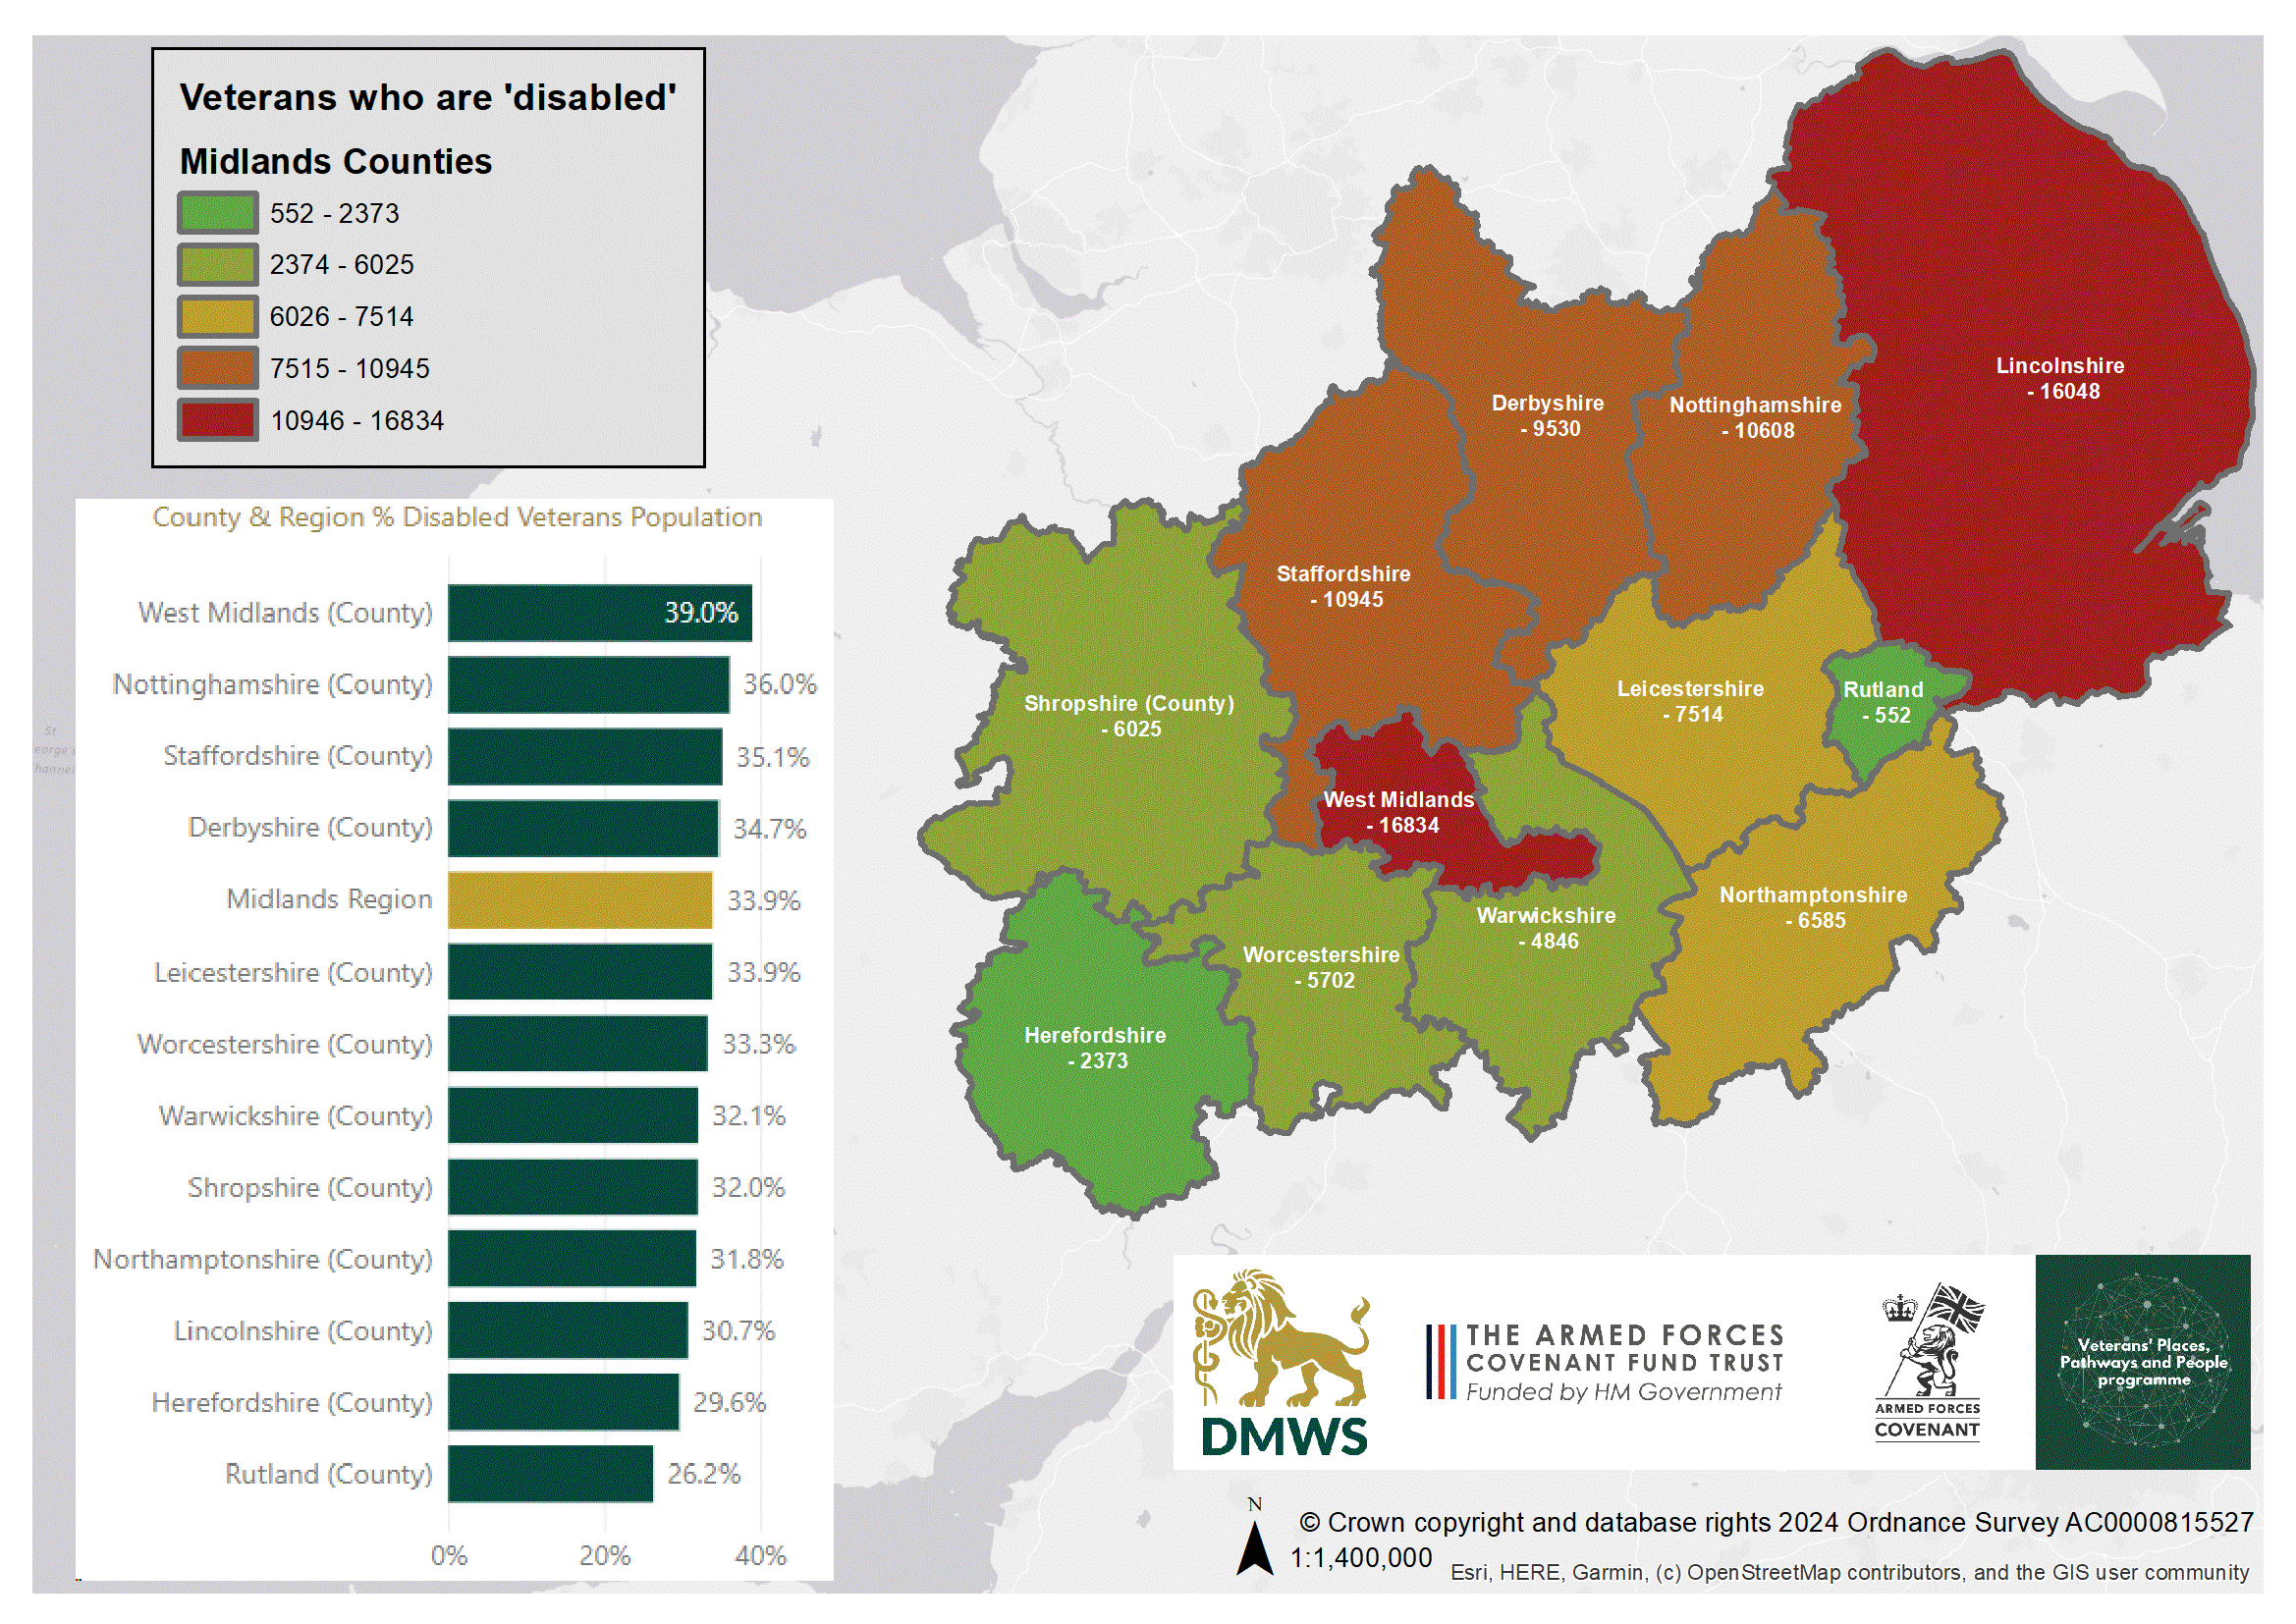
Dotted line = average age band %

Slide 12
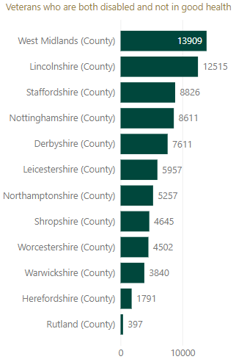
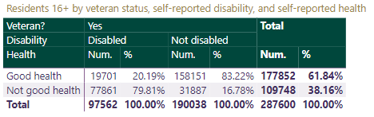
Health x Disability – Midlands
Considering Health x Disability, the number of disabled veterans who are also classified as being "not good health" (NGH) is 77,861. Many of those veterans could be expected to have complex care needs.
The number of veterans in this cluster by county in the region is shown in the adjacent table, from highest (West Midlands) to lowest (Rutland).
The table below shows intersection of disability and health – only 20.19% of disabled veterans report “good health”, compared to 83.22% of non-disabled veterans, which is a statistically significant difference.
wolverhampton.gov.uk

Slide 13
Key Findings (Employment, qualifications, housing) – Midlands
The veteran population aged 16-64 (the usual ‘working age’ definition) is more likely to be in employment, and less likely to be unemployed, than the non-veteran cohort.
Within the 16-64 cohort, the qualification profile for veterans is also better than for non-veterans.
Veterans are likelier than non-veterans to live by themselves, even after adjusting for age and sex.
Deprivation levels tend to be lower for veterans than non-veterans, perhaps a result of higher employment levels amongst working-age veterans, affording them the opportunity to live in less-deprived areas.
wolverhampton.gov.uk

Slide 14
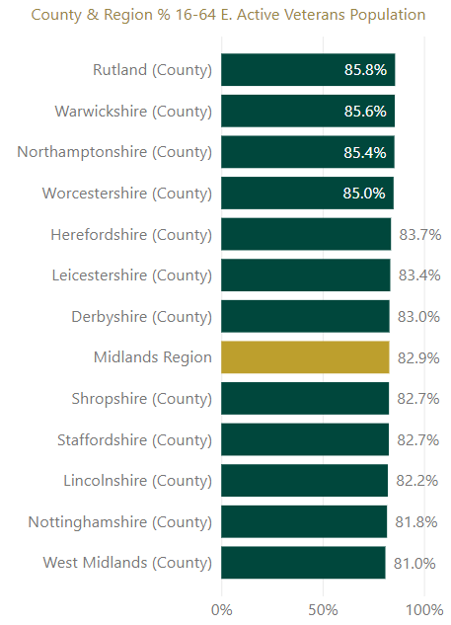
Economic activity status of veterans aged 16-64 – Midlands
Economically active = ‘in employment’ or are ‘unemployed but looking for work’ at the time of the Census.
Economically inactive population is not in work nor looking for it – often retired, but there are other possibilities such as being long-term sick, ‘looking after home and family’, and students who are not looking for a job.
The veteran population aged 16-64 (the usual ‘working age’ definition used in official statistics) is more likely to be economically active (82.9%, substantially higher than the non-veterans’ 74.22%).
Economic activity is useful as there is comparatively little information or intelligence about outcomes for service leavers post-Service.
wolverhampton.gov.uk

Slide 15
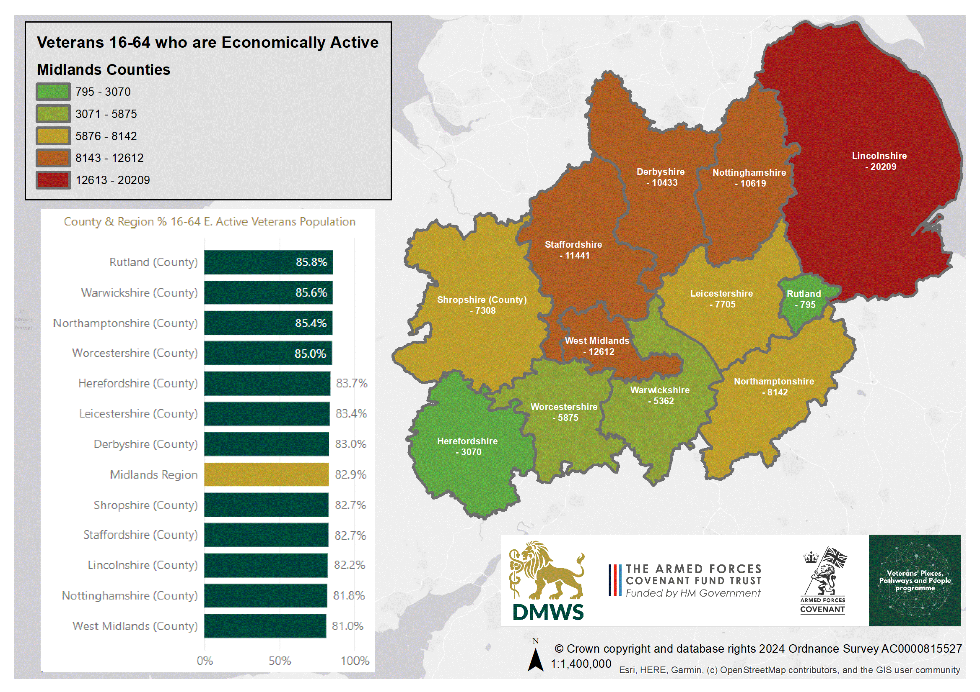
Dotted line = average age band %

Slide 16
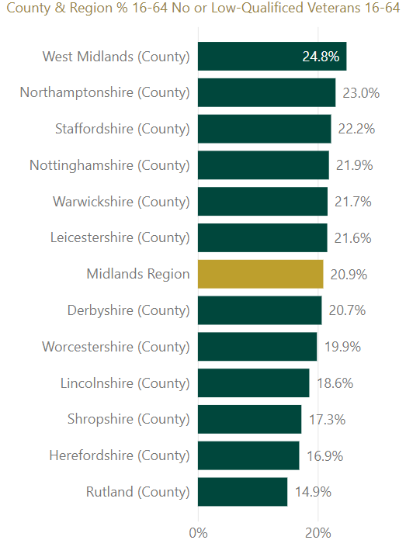
Qualifications of veterans aged 16-64 – Midlands
A high employment rate for the veterans, especially when compared to the non-veterans’ population, perhaps evidences the utility of skills and knowledge gained during Service life, and one way to assess this is the qualifications profile of veterans.
The data shows that, for the 16-64 year old ‘working age’ population, veterans have a better qualification profile, as a cohort, than non-veterans. 20.94% of veterans had only no or low (L1) qualifications, compared to 25.02% of non-veterans.
‘Level 1’ (L1) qualifications are described as being: 1 to 4 GCSEs grade A* to C, Any GCSEs at other grades, O levels or CSEs (any grades).
This better qualification profile will explain to some extent why veterans are more likely to be in employment.
wolverhampton.gov.uk

Slide 17
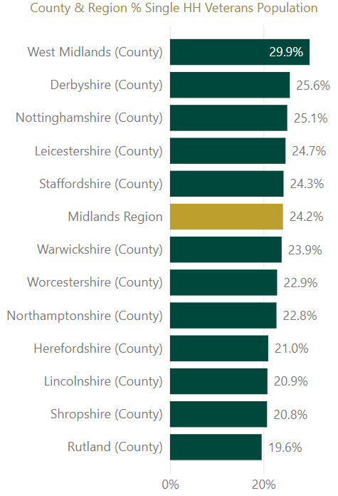
Housing / Household Composition – Midlands
Responses to the Census are used to calculate household composition, which refers to the relationship between household members. For example, a household might consist of a family, of unrelated adults living together, or it might just be one person living alone.
The most common non-Familial housing type for veterans is a single-person household, as ﻿68,317﻿ (﻿24.19%﻿) of veterans lived in this housing situation, compared to ﻿15.08%﻿ of non-veterans
Rates of single-person household living increase with age, for veterans’ households, peaking at ﻿41.45%﻿ for the 85+ cohort. The equivalent percentage of non-veteran households aged 85+ where someone lives alone is ﻿59.57%﻿, which is perhaps attributable to more older (non-veteran) females living by themselves.
Not all veterans live in a household setting, some veterans will live in a “communal establishment”, such as a halls of residence or a nursing home for instance.
wolverhampton.gov.uk

Slide 18
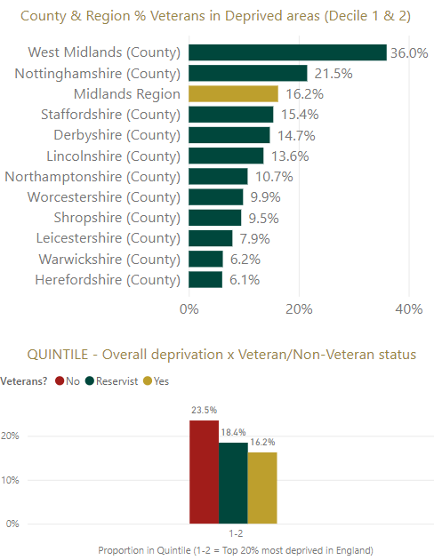
Deprivation of veterans – Midlands
This dataset combines the Census 2021 UK Armed Forces indicator, with the Indices of Deprivation 2019 dataset from Ministry of Housing Communities & Local Government (MHCLG).
Deprivation is defined by MHCLG as “encompass[ing] a wide range of an individual’s living conditions…people can be regarded as deprived if they lack any kind of resources, not just income”.
The data looks at ‘small areas’ (Lower Super Output Areas), and the ‘small areas’ are ranked according to levels of deprivation therein. The worst 10% of areas are in decile 1, the second-worst 10% of areas are in decile 2. This “top 20%” cutoff is a usual threshold for deprivation.
Comparing where veterans live against non-veterans, the veteran population is less likely to live in a deprived area (16.2% for the region). However, the veteran population is varied in how likely they are to live a deprived area, from 6.1% (Herefordshire) to 36.0% (West Midlands), which reflects the divergent underlying socio-economic conditions in different local authority areas of the region.
wolverhampton.gov.uk

Slide 19
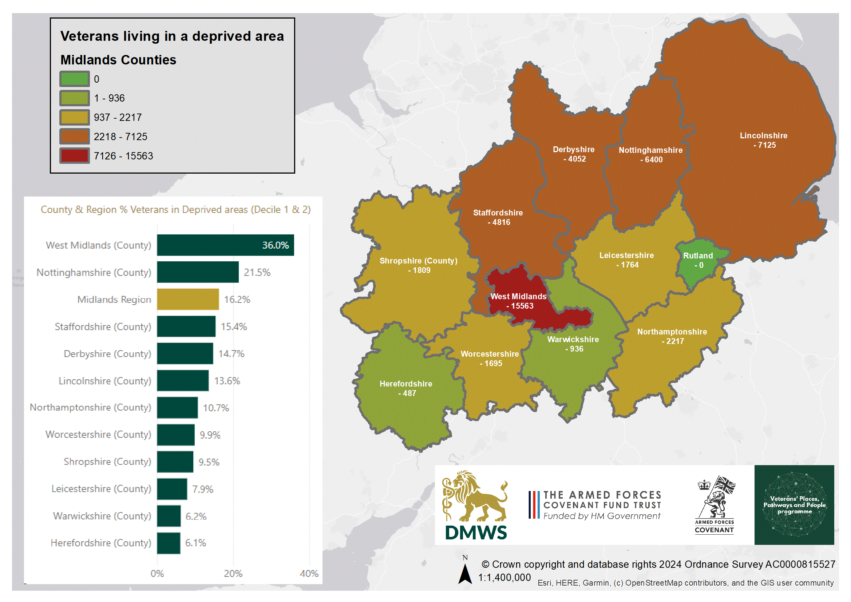
Dotted line = average age band %

Slide 20
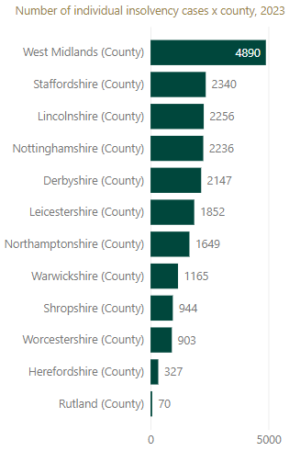
Debt (Insolvencies) – Midlands
Within this region, the Insolvency Service recorded 20,779 cases in 2023, the highest number in West Midlands (4,890), and the lowest in Rutland (70).
These are not necessarily insolvencies involving veterans, but the wider population of the area as a whole.
Individual insolvency data for England & Wales were extracted from the Insolvency Service case information system (ISCIS) in January 2024. These statistics present bankruptcies, debt relief orders (DROs) and individual voluntary arrangements (IVAs), in a single unified group
Individual voluntary arrangements (IVAs) in England & Wales are counted within these statistics once they are registered with the Insolvency Service, and they are reported by year of registration date. There is often a time lag between the date on which the IVA is accepted (known as the date of creditor agreement) and date of registration by licensed insolvency practitioners working for firms that specialise in this area. For some IVAs, the year in which they were registered may differ from the date of creditor agreement.
wolverhampton.gov.uk

Slide 21
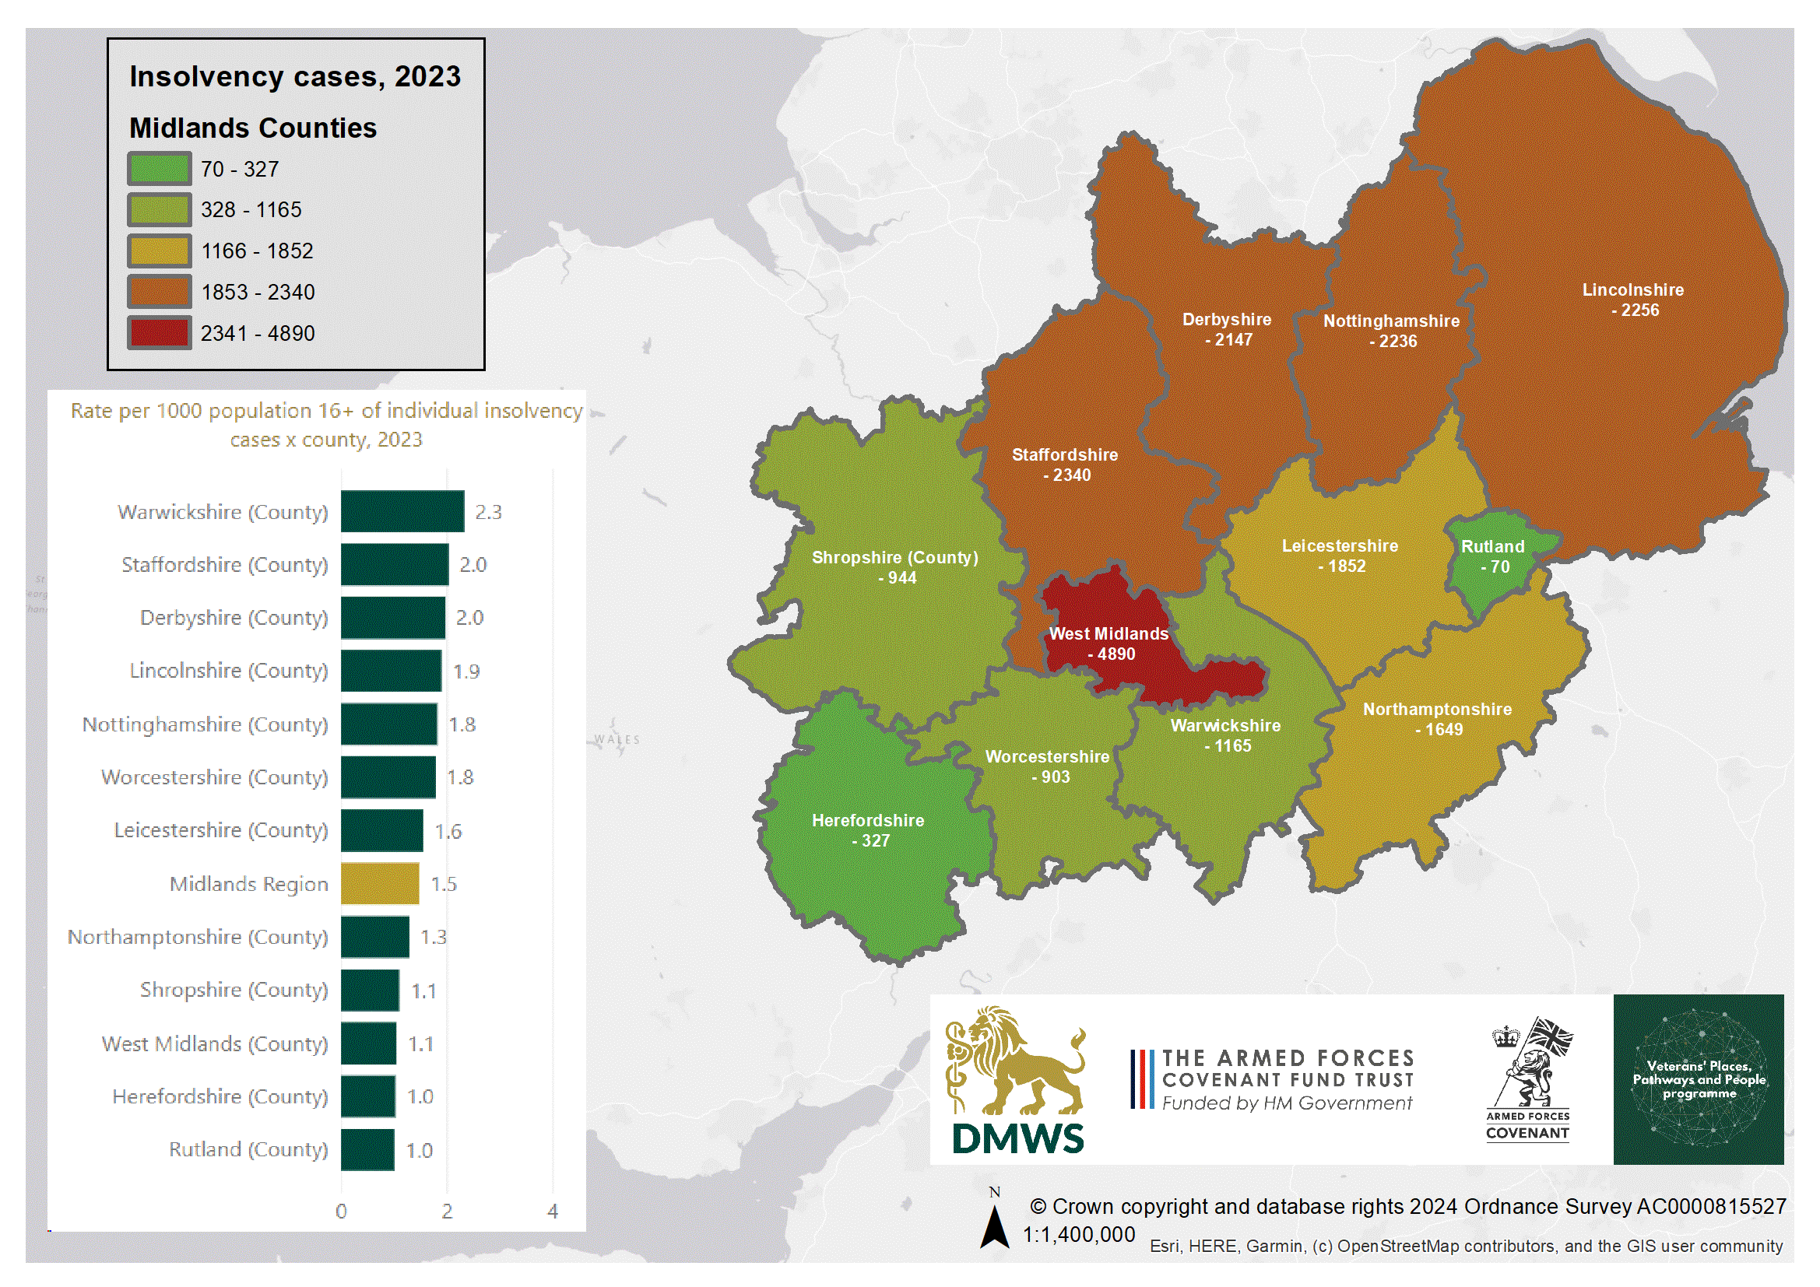
Dotted line = average age band %

Slide 22
Adrian Barlow
Senior Analyst,
City of Wolverhampton Council
adrian.barlow@wolverhampton.gov.uk
01902 554043

Slide 23
wolverhampton.gov.uk

